Slide 1
IANR WEB MANAGER NETWORK
Meeting 1/18/2018 9:00 a.m.

Slide 2
Meeting Agenda
Web Manager Network Update – Anne Holz
HTML/CSS style guide – Anne Holz
WDN Live Chat and MediaHub – Aaron Coleman

Slide 3
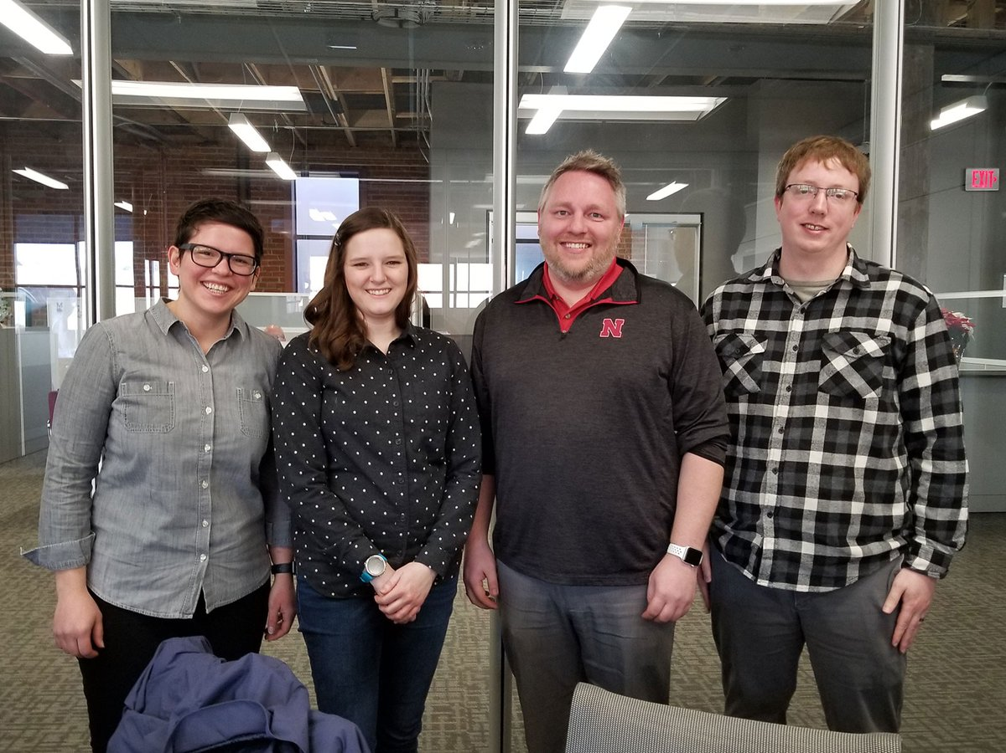
Update
Newly elected WDN Shared Governance Board Members
Ella Durham
Erin Chambers
Michael Riese
Michael Fairchild

Slide 4
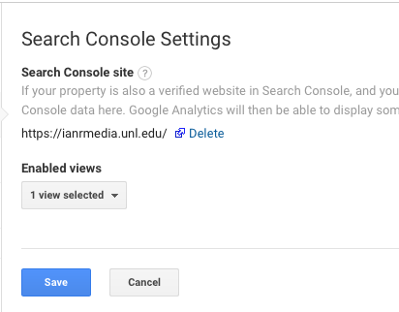
Update
Extended Google Analytics “Scheduled Emails” end dates
Added https property in Google Search Console
Associated https property with Google Analytics
Google Analytics>Admin>Property>Property Settings>Adjust Search Console

Slide 5
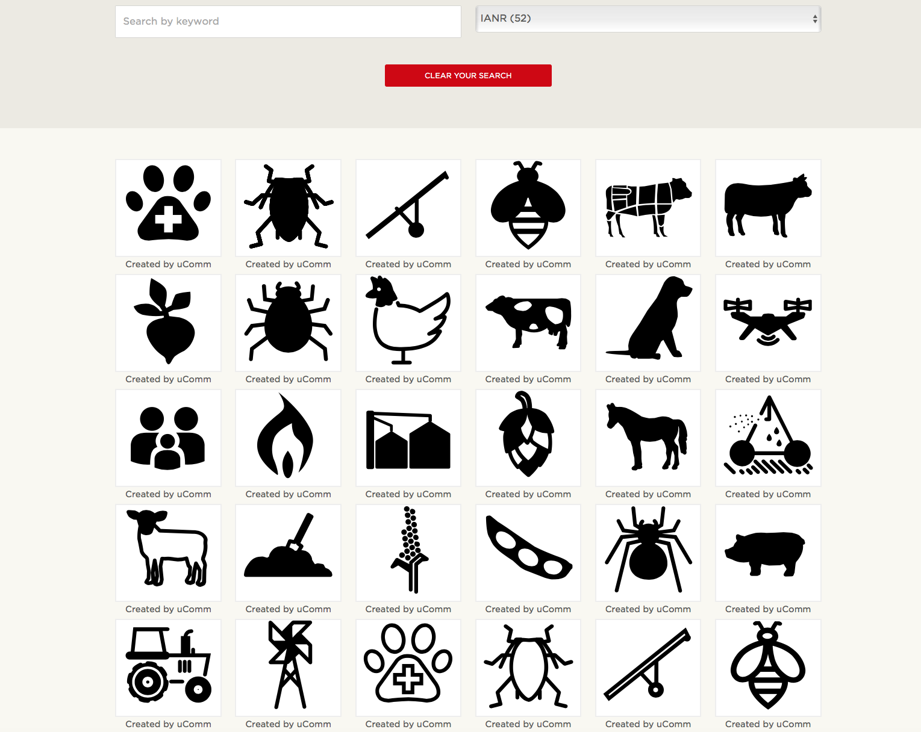
Update
Agricultural Icons added to icon factory
Select “IANR” in “Browse by category” dropdown
https://ianrmedia.unl.edu/resources

Slide 6
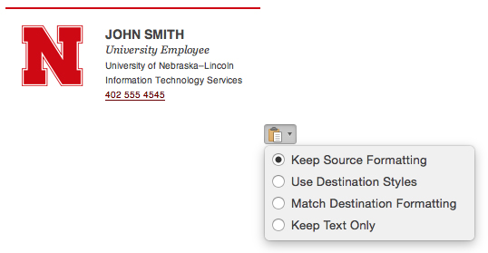
Email Signature Generator
ucomm.unl.edu Tools>Email Signature Generator
Ensures you’re using the most current “N” lockup
Provides a template for consistent use within departments and units
https://ucomm.unl.edu/signature-generator

Slide 7
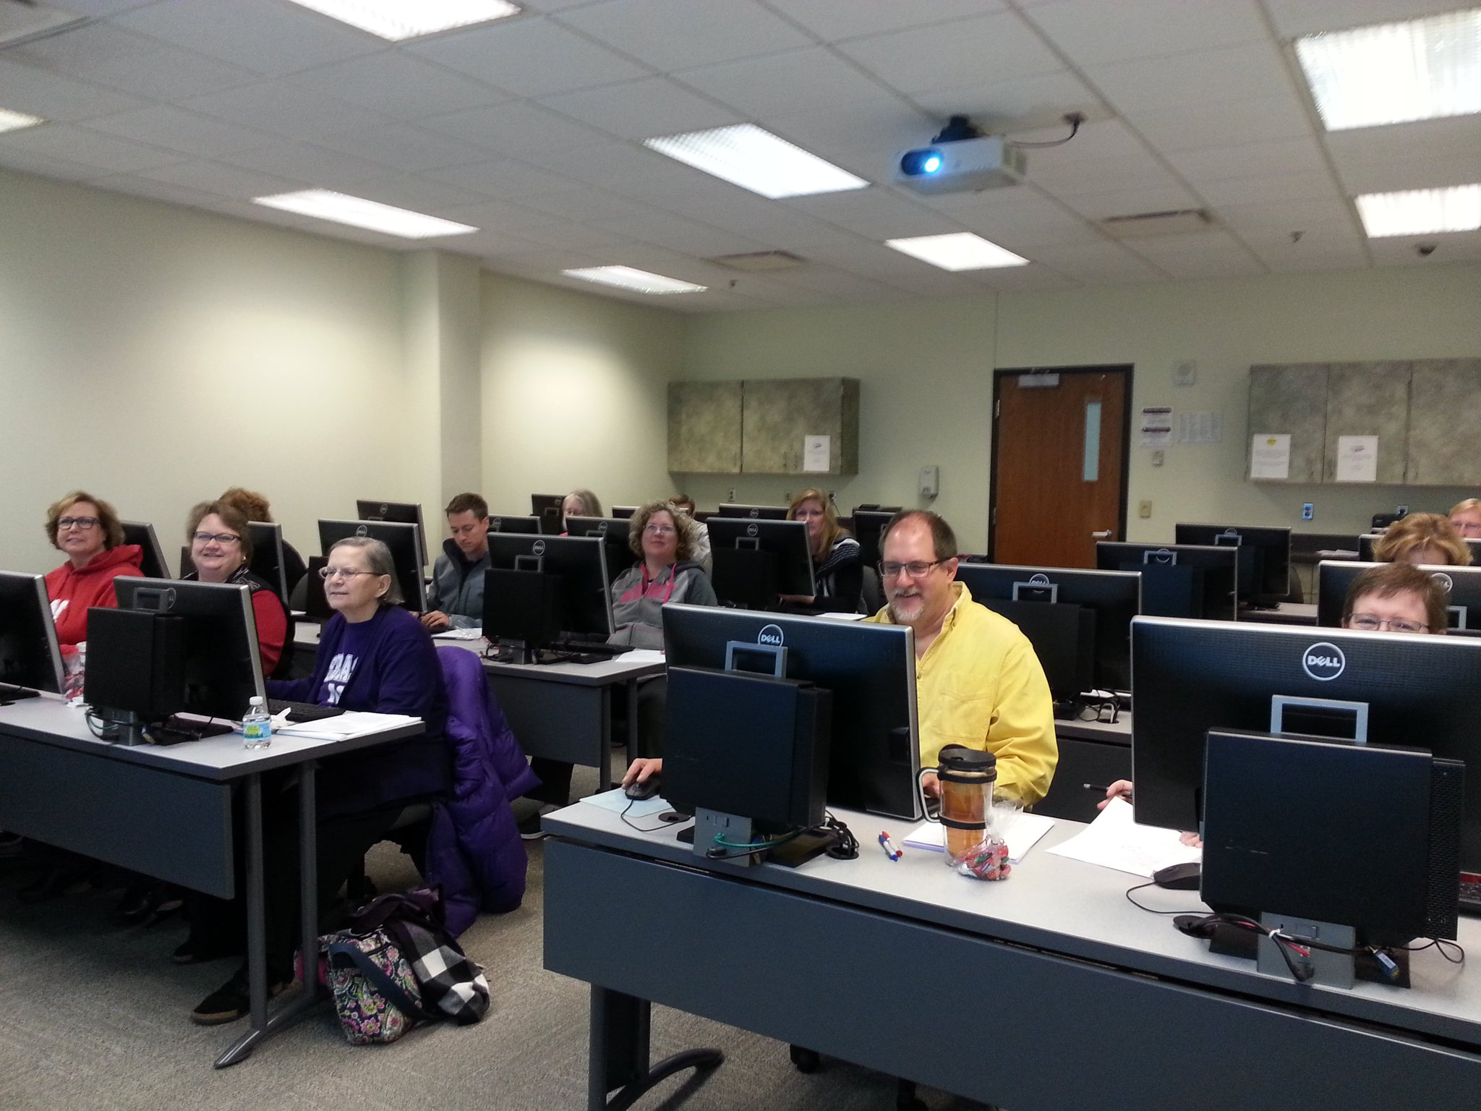
Next hands-on workshop (June or July)
Possible Topics
WebAudit Report
Search Engine Optimization (SEO)
Google Search Console

Slide 8
HTML/CSS Style Guide

Slide 9
HTML/CSS Style Guide
Why follow a style guide?
Easier for others to read and understand your code
Looks more professional
Easier to find and avoid errors
https://ianrmedia.unl.edu/resources/html-and-css-style-guide

Slide 10
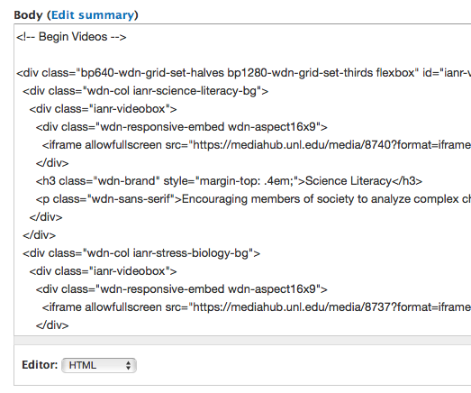
An HTML/CSS Style Guide Dictates
How many spaces to indent tags
How comments should look
Which letter case to use
When to start a new line
Which units to use (em, rem, px)

Slide 11
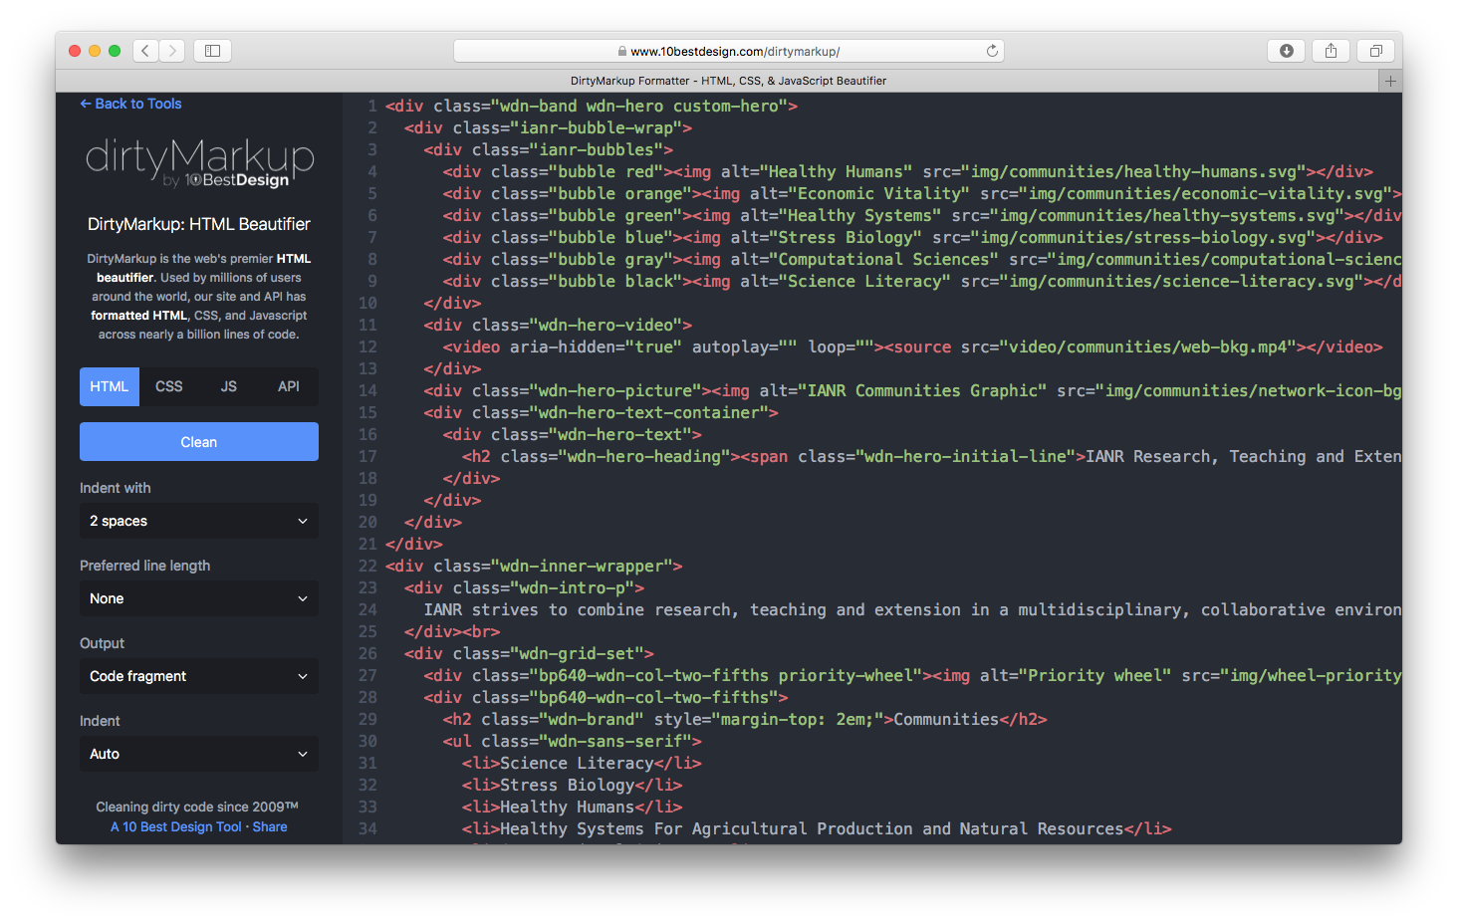

Slide 12
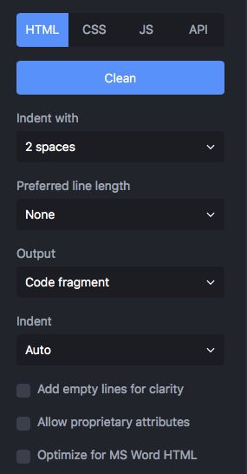
DirtyMarkup Tool to Cleanup HTML and CSS
Select settings
https://www.10bestdesign.com/dirtymarkup/
Adds missing closing tags
Lowercases all tags and attributes
Indents child code 2 spaces
Removes extra returns

Slide 13
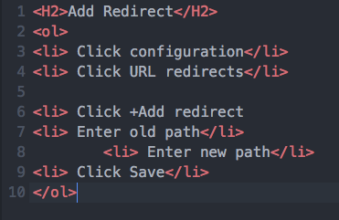
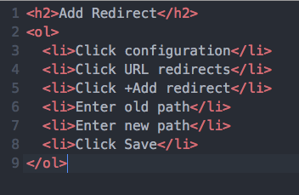
Should be lowercase
Before
After
Should not have a return
Missing </li>
All <li> tags should be indented 2 spaces they are a child of <ol>

Slide 14
References
DirtyMarkup Tool https://www.10bestdesign.com/dirtymarkup
HTML/CSS Style Guide https://ianrmedia.unl.edu/resources/html-and-css-style-guide
Icon Factory https://ianrmedia.unl.edu/resources
Email Signature Generator https://ucomm.unl.edu/signature-generator

Slide 15
WDN Online Help Chat and Media Hub

