Slide 1
IANR WEB MANAGER NETWORK
Meeting 9/21/2017 9:00 a.m.

Slide 2
Meeting Agenda
Web Manager Network Update – Anne Holz
Working with Web Images in Photoshop – Tim Svoboda

Slide 3
Update
Hands-on Workshop - Google Analytics Basics on November 10, 2017
WDN Governance Board nominations in Oct. (3 new members will be elected in December)
Hands-on Workshop - Google Analytics Basics Register online at http://ianrmedia.unl.edu

Slide 4
Web Audit HTTPS Security errors (images, javascript, CSS, embeds)
Change to a relative path: img/tailgate/tailgate2017.png
Or replace http with https:
https://ianr.unl.edu/img/tailgate/tailgate2017.png
This error will go away after Oct 1

Slide 5
All of these are valid image path options:
src=''https://ianr.unl.edu/image/campus.jpg''
src=''/image/campus.jpg''
src=''image/campus.jpg''
Recommended for consistency with the UNLcms WYSIWYG Editor’s Insert/Edit Image

Slide 6
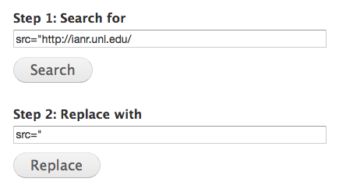
Search and Replace image path
This will replace image full paths with relative paths

Slide 7
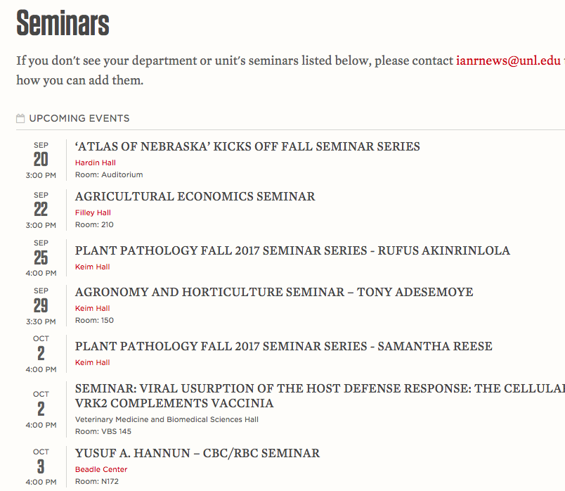
UNL Event calendar seminars (include seminar in title)

Slide 8
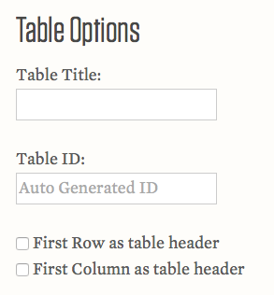
Responsive Table Generator new features
Convert existing table to responsive
Unique IDs. Leave blank or add custom ID.
Example IDs: t1, t2, t3…
http://ianrmedia.unl.edu/resources

Slide 9
Working with Images in Photoshop

