Slide 1
IANR WEB MANAGER NETWORK
Meeting 7/21/2016 9:00am

Slide 2
Meeting Agenda
IANR Web Manager Network Update – Anne Holz
Search Engine Optimization (SEO)– Anne Holz

Slide 3
IANR Web Manager Network Update

Slide 4
Update
New Icon Factory PNG download feature
Part 2 of “How To Add Pizzazz to Your Site” will be presented at the August 18th Meeting
UNLCMS WYSIWYG editor preview was updated to properly display grids with breakpoints

Slide 5
Update
Webaudit report now checks for icon accessibility http://wdn.unl.edu/documentation/icons
<span class="wdn-icon-rocket" aria-hidden="true"></span><span class="wdn-text-hidden">rocket icon</span>
Notes:
aria hidden=“true” hides content just from screenreaders.

Slide 6
What is SEO?
SEO stands for Search Engine Optimization
SEO is a process for making your site more visible in search engines like Google
Good SEO increases organic traffic

Slide 7
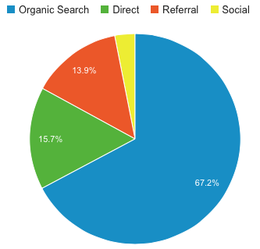
Organic Traffic
IANR Media Traffic Channels
June 2016
Traffic that reaches your site when a user clicks a search results link that is not a paid ad
Other types of traffic include referral, social, direct, email and paid search

Slide 8
Organic search result links Paid search result links
Notes:
Organic page ranking is free and achieved by practicing good SEO. Paid results are ads that display at the top and bottom of search results on desktop displays, ads have “Ad” displayed next to them.
Company’s purchase adword ads to try and get their site listed on page one of google search results when someone types in keywords related to the products or services they offer. They can pay per click (cpc) or per thousand impressions (cpm). When paying per click, everytime someone clicks the link, the company gets charged. The amount they pay varies based on their bid amount, competition and ad optimization.

Slide 9
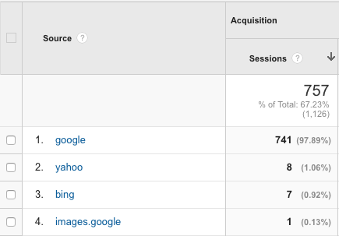
Top Search Engines
IANR Media Organic Traffic Source
June 2016
Google
Bing
Yahoo
Notes:
Though there are numerous search engines, Google is usually the top search engine to consider for SEO. Most of the SEO strategy’s that work for Google will work for other search engines as well.

Slide 10
Good and Bad SEO
Knowing what you should do is just as important as knowing what you shouldn’t do

Slide 11
Things You Should Know About SEO
There are no guarantees
Beware of hiring an SEO company, not all can be trusted
Beware of SEO software
Unethical SEO practices can get your site removed from Google

Slide 12
Avoid tactics that can harm your site’s SEO
Keyword stuffing
Cloaking
Hiding text
Scraped content
Doorway pages
Deceptive redirects
Notes:
Sometimes bad SEO practices happen unintentionally. Either a site manager is unaware of best practices or their site gets hacked. Unfortunately a search algorithm is a computer program, it’s not going to know if something was intentional or not, it just sees that it’s wrong.

Slide 13
Keyword Stuffing
http://seopressor.com/wp-content/uploads/2015/08/keyword-stuffing.gif
Notes:
Stuffing keywords is the practice of repeating irrelevant keywords, that you want to rank for, in text where they sound unnatural. Another keyword stuffing practice is to list a bunch cities and states on the page in an attempt to rise to the top of search results based on location.

Slide 14
Cloaking
http://www.godoveryou.com/what-is-cloaking
Notes:
Cloaking is when a site shows different content to a search engine than it shows a human. It can be an entire site or a part of a site such as swapping out a promotional graphic with keyword rich text.

Slide 15
Hiding Text
color: #ffffff; background-color: #ffffff;
text-indent: -999px;
display: none
font-size:0
z-index:-1
Notes:
Hiding text from users but not search engines, white on white, layering behind an image (z-index), positioning off the page with CSS, setting font size to 0, linking a punctuation mark instead of the text. JavaScript used for dropdown menus and mouse overs are ok.

Slide 16
Scraped Content
Content that is copied from one site and pasted onto another
Not to be confused with curated or syndicated content
No attribution
No original content added
Same content displays in two places or with a little rewording or swapped out synonyms
No explanation for duplication
Notes:
Scraped content is content copied from another site and pasted onto a page on your site. It’s better to link to the page on the other site than to duplicate its content. Modifying it slightly is still considered scraping (article spinner). Displaying nothing but feeds from other sites is considered scraping. The line between scraped and non scraped is crossed when you add original content to the page and organize it to benefit the user.
Not to be confused with curated or syndicated content which provides attribution and links back to the original source

Slide 17
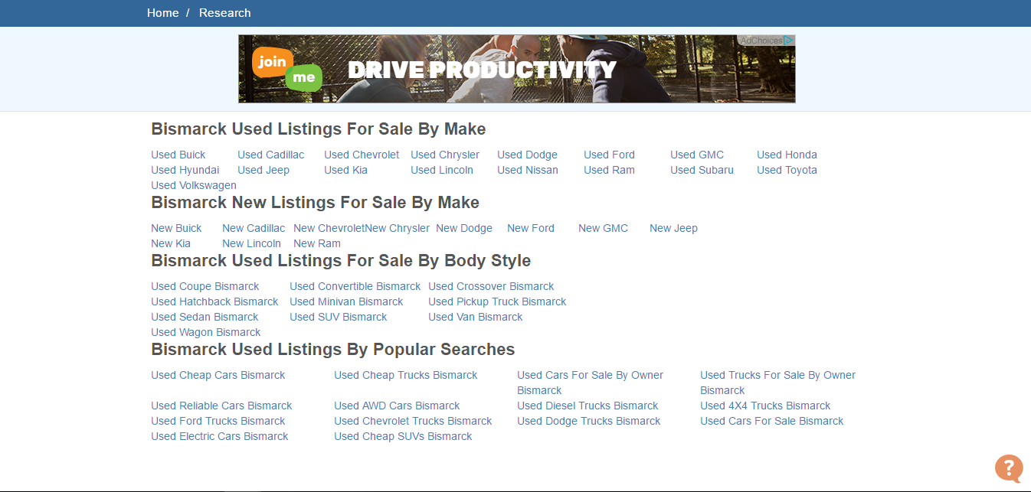
Doorway Pages
Notes:
Doorway pages are solely designed to rank high in search engines, not for users, and then once they get the user there they funnel them to the actual page.

Slide 18
Doorway Pages
Spammy looking pages with nothing but a bunch of text links
Same page is auto generated multiple times with a different city or name dynamically inserted
Links in search results all go to the same site
Notes:
Sometimes referred to as link farms.

Slide 19
Deceptive Redirects
Link takes you to a page with unexpected content, typically one that looks like spam
Practice performed by hackers
Used for doorway pages and cloaking
Notes:
Deceptive redirects are ones that don’t take you to a page with the type of content you were expecting to see, typically one that looks like spam. This is a practice performed by hackers.

Slide 20
Practicing Good SEO Involves
Site structure
HTML
Links
Content
Authority
Social

Slide 21
Two Types of SEO
On-site SEO
Architecture, internal links, content and markup on your site
Off-site SEO
Links on other sites to your site… authoritative sites, blogs, Facebook, Twitter etc.
Notes:
On-site SEO is where you can make the biggest difference.
For off-site SEO, it’s not the number of inbound links that matters it’s the quality.

Slide 22
SEO Benefits Beyond Search
Good SEO improves the user experience on your site
What’s good for SEO is also good for accessibility
Having a responsive site improves mobile SEO

Slide 23
Site Structure
Plan your site structure
Maximum of six main navigation links and up-to or around six sub navigation links
Don’t repeat links in your navigation
Navigation should link to pages on your site, not pages on other sites
You should be able to get to any page on the site by clicking links, starting from the front page
Notes:
There is an exception where you can link your navigation to another site but only if the other site’s breadcrumbs link back to your site.

Slide 24
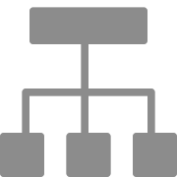
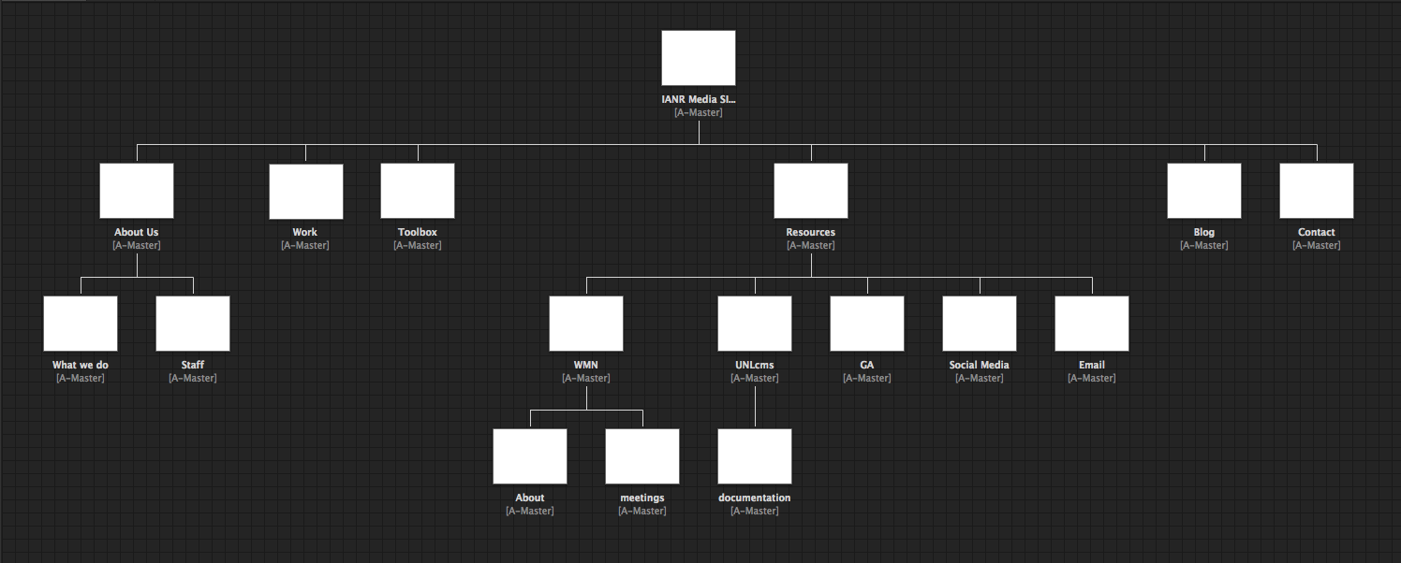
IANR Media Site Structure created in Adobe Muse on the plan screen

Slide 25
Site Structure
Main navigation should be more general than sub navigation
Sub navigation pages should link to pages with more specific detail
You should be able to categorize every page on the site into one of the main navigation sections
Not every page needs to be a link on the navigation
Avoid going more that 3 levels deep in the page hierarchy

Slide 26
Level One
Level Two
Level Three

Slide 27
Site Structure
Use text links/buttons for navigation instead of graphics
The front page should link to the most important information for users
Use internal links to help users navigate the site

Slide 28
Pages Indexed by Search
Search engines crawl a site to index the site’s pages
The more pages indexed, the greater chance people will find your site
You can view the number of pages indexed in google by searching site:yourdomain.unl.edu

Slide 29
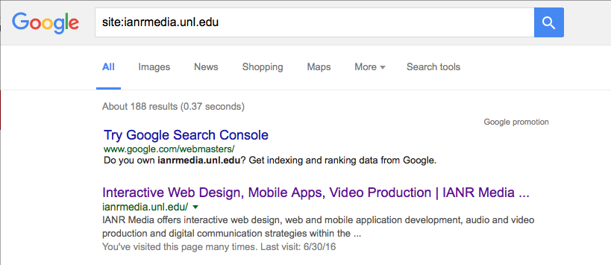
IANR Media number of indexed pages

Slide 30
Why Pages Don’t Get Indexed?
Improper canonicalization
Poorly configured .htaccess file
Manual google penalties
Bad HTML
Disallow in the robot.txt file
Robots Meta Tag <meta name="robots" content="noindex, nofollow">

Slide 31
canonicalization
The URL of your front page should be the same, no matter what you type in to get to it.
www.ianrmedia.unl.edu
ianrmedia.unl.edu
ianrmedia.unl.edu/home
ianrmedia.unl.edu/aboutus
All of these go to ianrmedia.unl.edu

Slide 32
Google Analytics splitting front page data

Slide 33
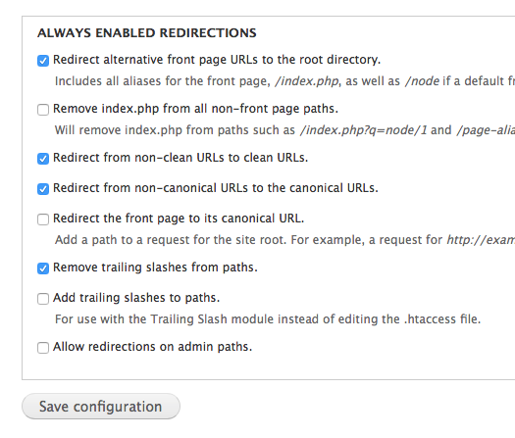
UNLcms
Turn on “Redirect” Module
Go to Configuration>URL redirects
Click the “Settings” tab
Check “Redirect alternative front page…” and click “Save configuration (you must click save, even if it was already checked by default, just turning on the module is not enough)

Slide 34
Canonicalization
A canonical tag tells a search engine the content is a copy so that the site or page it originated from is more likely to get credit and rank for it in search engines.
<link rel="canonical" href="http://ianrnews.unl.edu/article1" />
The canonical tag of original content should include the URL of the page. The canonical tag of duplicate content should include the URL of the page it’s duplicating.

Slide 35
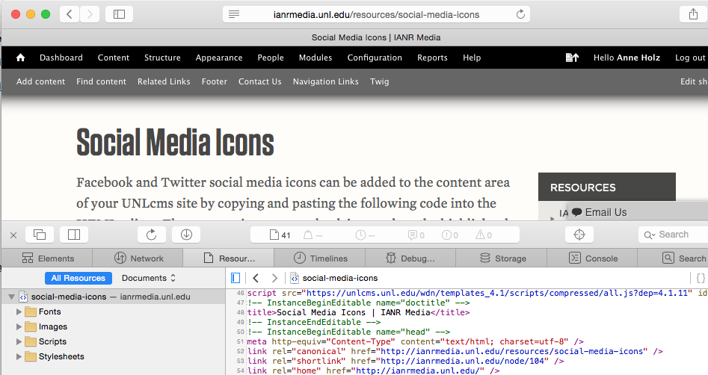
Same URL for Original Content

Slide 36
Why Pages Don’t Get Indexed (Cont.)?
Site requires username and password to view
Sitemap needs updated
Site was created with flash
Slow page load time
Too many links on a page

Slide 37
HTML
Title Tag
Meta Description Tag
Headings <h1>…<h6>
Image tag alt attribute

Slide 38
Title Tag
Meta Description

Slide 39
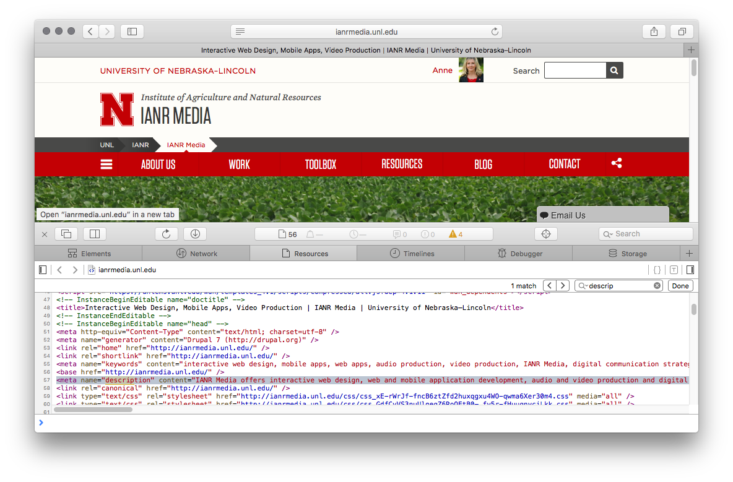
Title Tag
Meta Description

Slide 40
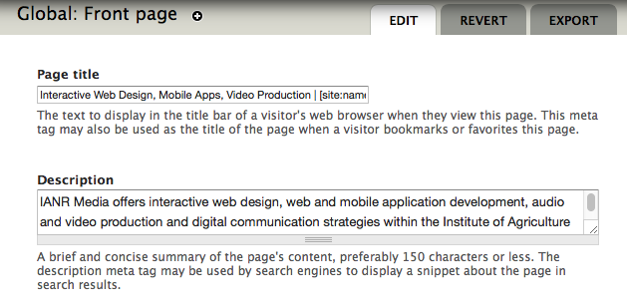
Front Page Title Tag and Meta Tag Description
Turn on “Meta Tags” Module
Go to Configuration>Meta tags
Click edit next to “Global: Front page
Enter Page title and Description Keyword phrases separated by commas | [site:name] | University of Nebraska–Lincoln

Slide 41
Page Title
Most important element for SEO
Displays in <h1> tag, <title> tag and URL by default in UNLcms
Include relevant keywords

Slide 42
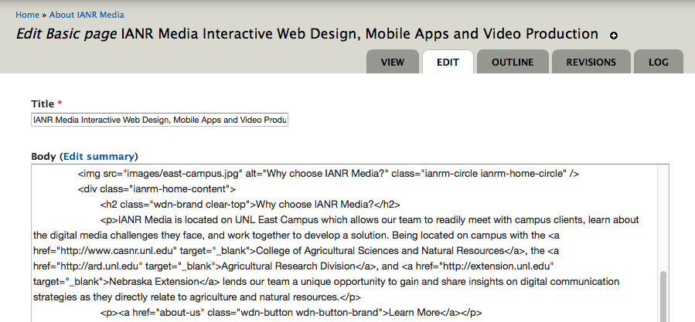
Page Title

Slide 43
Image Alt Text
Alt text should describe the image in a way that someone who can’t see it would know what it’s about
All images should have alt text unless they are purely for decoration like a background image
Alt text for images used for navigation should describe the content they link to

Slide 44
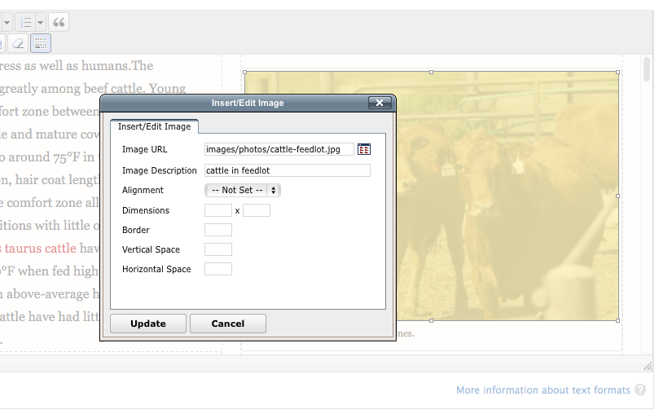
Alt Text in UNLcms WYSIWYG Editor

Slide 45
Links
Link keyword phrases
Use rel=“nofollow” on links you don’t want search engines to pass page rank to
Only link to authoritative sites (.edu, .gov, etc.)
Notes:
Links are also referred to as anchors.

Slide 46
Headings
<h1> is the most important heading and should contain the page title
Only one <h1> on a page
Use headings in descending order <h1>…<h6>

Slide 47
Headings
Use <h1>…<h6> tags only around headings, not for formatting non-heading text
Include relevant keywords
Should be followed by text for the heading

Slide 48
Links (Cont.)
Linked text should describe the content you’re linking to
Try to limit the number of links on a page to less than 100 (the header and footer regions already take up around 30-50 links)
Link to deeper, lower level pages from top pages to increase their page rank

Slide 49
Links (Cont.)
Vary the anchor text on a page for links that go to the same page
Use keywords that describe what users will see when they click the link, instead of linking “click here” or URLs
The fewer amount of links on a page, the higher the ranking power they’ll have

Slide 50
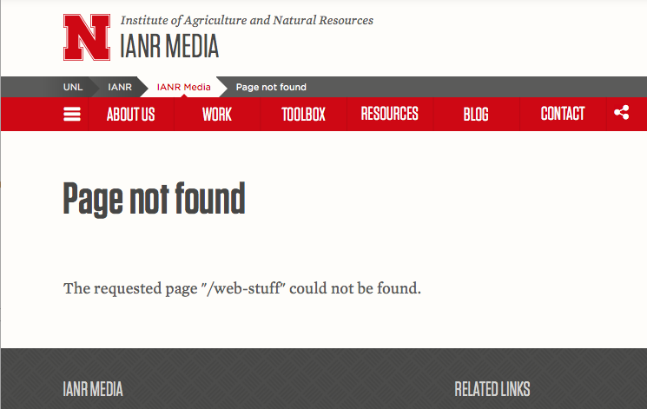
Add 301 Redirects to Keep Ranking Power
Redirect moved pages to the new page
Redirect deleted pages to a page with similar content
Notes:
Links are also referred to as anchors.

Slide 51
Links (Cont.)
Use the search engine friendly version of your site’s URLs for internal links, not the one with node/#
http://ianrmedia.unl.edu/node/122
http://ianrmedia.unl.edu/resources/website-best-practices
Notes:
Links are also referred to as anchors.

Slide 52
Inbound Links
Links to your site from another site (referring sites)
Sometimes called backlinks
Affect off-site SEO
Quality is more important than quantity
Good inbound links come from authoritative sites

Slide 53
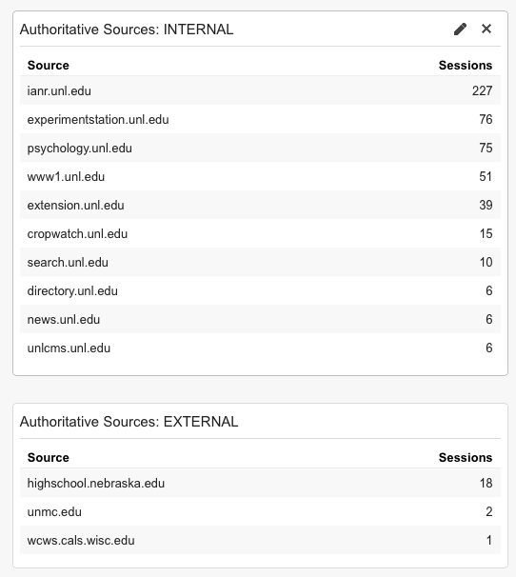
Authoritative .edu and .gov sites linking to IANR Media
Google Analytics
Dashboards>Shared>
Traffic Overview - IANR

Slide 54
Content
The goal of a search engine is to return good results
Unique content
Relevant content
Up-to-date
Changing

Slide 55
Keywords
Relevant to the page content
Words someone is likely to type in a search to find the type of content on your page
Has two or more words in the phrase
Notes:
Long tail keywords contain 3 or more words that are very specific and are easier to rank for because they have less competition.

Slide 56
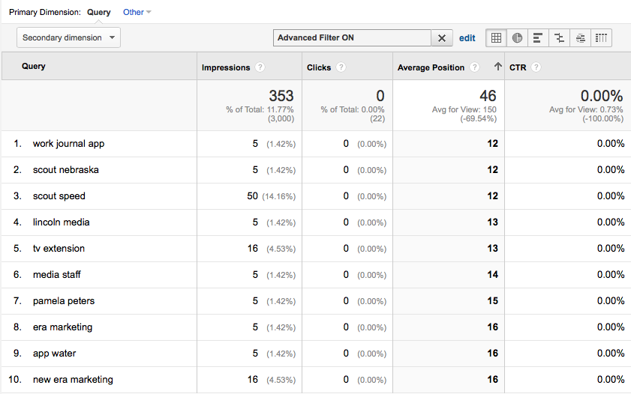
Keyword Research
Google Analytics: Acquisition>Search Engine Optimization>Queries
Notes:
Use keyword research to see what people are searching and how well your site ranks for that phrase.

Slide 57
Images
Use HTML to add text on an image instead of making it part of the image itself
Give your images descriptive names prairie-rattlesnake.jpg img00015.jpg
Use hyphens to separate words prairie-rattlesnake.jpg prairierattlesnake.jpg

Slide 58
Authority
Authoritative inbound links (.edu, .gov, top news sites etc.)
Original, quality content written by an expert (.edu and .gov sites)
Trusted, secure content (https)
Not a lot of ads
https://webmasters.googleblog.com/2011/05/more-guidance-on-building-high-quality.html

Slide 59
Social
In 2014 Google’s Matt Cutts said social signals such as Facebook likes and Twitter followers do not affect search rankings.
https://www.youtube.com/watch?v=udqtSM-6QbQ

Slide 60
How Does Social Help?
Google + info can display in a Google knowledge graph
People search Social Media for information
Drives traffic to your site
Reinforces your brand
Notes:
Knowledge graph is the box of information about a business, author or brand that shows up on the right of Google search results

Slide 61
Resources
Google Search Engine Optimization Starter Guide http://static.googleusercontent.com/media/www.google.com/en//webmasters/docs/search-engine-optimization-starter-guide.pdf
Search Engine Land http://searchengineland.com
MOZ https://moz.com/

Slide 62
IANR WEB MANAGER NETWORK
Next meeting August 18
9:00AM – 10:30AM

