Slide 1
IANR WEB MANAGER NETWORK
Meeting Thursday Jan. 26, 2017 9:00am – 10:00am

Slide 2
Meeting Agenda
IANR Web Manager Network Update – Anne Holz
Google Analytics Reports– Anne Holz

Slide 3
Update
UNLcms help session hours
New WDN board members
Ianr-analytics@unl.edu
Tracking MediaHub videos in Google Analytics
New WebAudit errors
2016 review - IANR site enhancements
New WDN board members: Kyle Martens, Mike O’Connor, Hardik Patel and Becky Aiken

Slide 4
MediaHub in Google Analytics
Update: MediaHub
Tracks how many times a video was…
Played
Paused
Ended (played until the end)

Slide 5
MediaHub Analytics Code
Update: MediaHub
In UNLcms, go to Appearances>Settings and add the following JavaScript in Head HTML.
<script>
require(['analytics'], function(analytics) {
analytics.recordMediaHubEvents();
});
</script>
MediaHub Code
http://wdn.unl.edu/documentation/unl-mediahub/embed-code

Slide 6
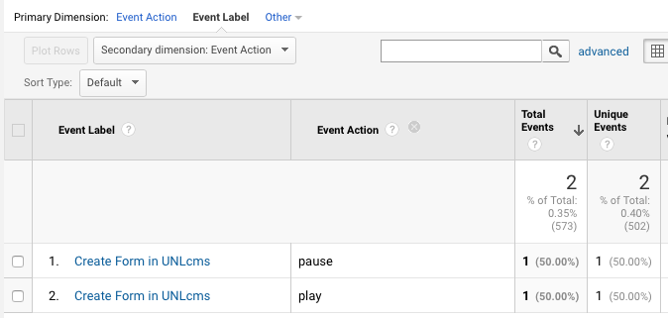
Update: MediaHub
Behavior>Events>Overview
Click the “Media” link to view MediaHub events.
event
label is the video title
event
action

Slide 7
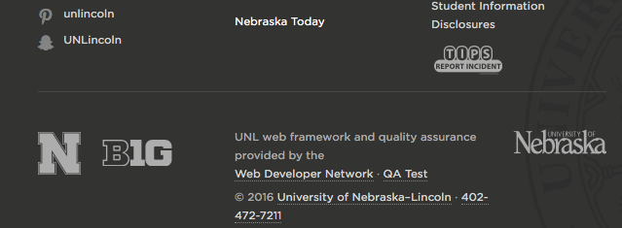
WebAudit
Update: WebAudit
“QA Test” link in page footer
AXE bookmarklet
Links to WebAudit Page Report

Slide 8
New WebAudit Errors
Update: WebAudit
Links must have discernible text (caused by linked image with no alt text)
Elements must have sufficient color contrast (must pass WCAG 2 AA)
Color Contrast Checker
https://snook.ca/technical/colour_contrast/colour.html#fg=33FF33,bg=333333

Slide 9
New WebAudit Errors
Update: WebAudit
An icon font was found without aria-hidden="true”
<a href="https://www.facebook.com/your-site" target="_blank">
<span class="wdn-icon-facebook" aria-hidden="true"></span>
<span class="wdn-text-hidden">Facebook</span>
</a>
Icon Font Sample Code
http://wdn.unl.edu/documentation/icons

Slide 10
2016 review – Site Enhancements
Update: Review
ALEC redesign alec.unl.edu
SNR and ARD card sorting
IANR twitter grid ianr.unl.edu

Slide 11
Google Analytics Reports
Measure, analyze and improve your site.

Slide 12
Google Analytics Reports
Google Analytics Reports
Who can run a report?
What does the data mean?
How do I know which data is spam?
How do I exclude my own hits?
How do I run a report for specific pages?

Slide 13
Who can run a Google Analytics report?
Google Analytics Reports
You need a Google Account
You need “Read & Analyze” permissions for the view
If you don’t have permissions they need to be assigned by someone with Account level access (ianr-analytics@unl.edu)

Slide 14
What does the data mean?
Google Analytics Reports
Google Analytics displays data in terms of Dimensions and Metrics
Dimensions are what you want to view data for like a page, referring sites, countries, cities, devices, etc.
Metrics are the quantitative values such as the number of sessions, the bounce rate, the number of pageviews, etc.

Slide 15
Google Analytics Reports
When generating or asking for a report, determine which dimensions and metrics you want to view.
One dimension
Two metrics

Slide 16
Google Analytics Reports
One report can contain up to two dimensions (a primary and secondary)
Primary Dimension
Secondary Dimension

Slide 17
Google Analytics Reports
Not every dimension can be combined with every metric
A Pages report doesn’t have sessions (use unique pageviews instead)
A Landing Page report doesn’t have pageviews
Dimensions and Metrics
https://support.google.com/analytics/answer/1033861?hl=en

Slide 18
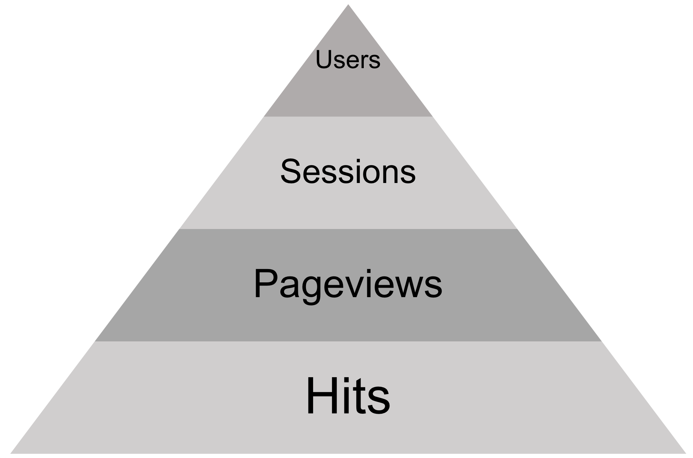
Google Analytics Reports
Visited the site from the same browser and device, resets after two years
Begins with a user’s first hit, resets after 30min of no activity
Any interaction that sends data to GA-- pageviews, downloading a file, clicking an external link, playing a video
Total number of pages viewed, including repeat views by the same user

Slide 19
How do I know which data is spam?
Google Analytics Reports
Spam is not real traffic
Most IANR sites have Bot Filtering turned on in Google Analytics to exclude known spam
Bot Filtering won’t catch everything
New spam pops up all the time inflating your analytics stats with false data

Slide 20
Hostname
Google Analytics Reports
Hostname is the same as domain name (ex: ianr.unl.edu)
Referral traffic that doesn’t come from a valid hostname is spam
An “include hostname” filter or segment can help filter out spam
A hostname filter/segment won’t catch all referral spam

Slide 21
Valid Hostnames
Google Analytics Reports
Your domain
Your subdomains
Other sites’ domains where you added the same Google analytics code
translate.googleusercontent.com
Sites like youtube or paypal

Slide 22
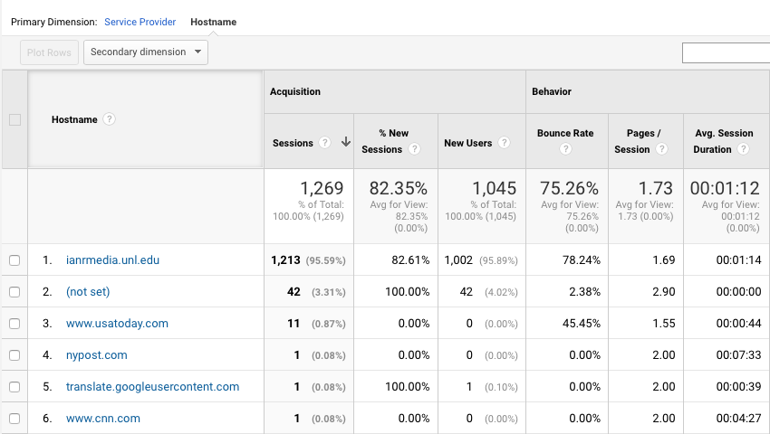
Google Analytics Reports
Audience>Technology>Network

Slide 23
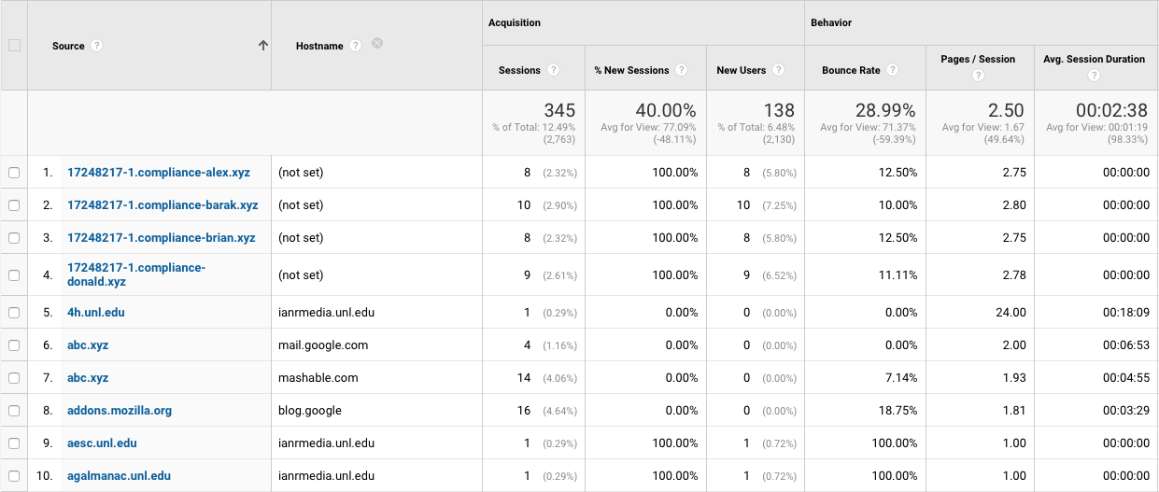
Google Analytics Reports
Acquisition>All Traffic>Referrals

Slide 24
How do I exclude my own hits?
Google Analytics Reports
“Exclude IP” filter, this will only work if your machine has a dedicated IP address
“Exclude IP” filter with a filter pattern to exclude a range of IPs
Install Google Analytics Opt-out Browser Add-on
IP Range Regular Expression Builder
http://www.analyticsmarket.com/freetools/ipregex

Slide 25
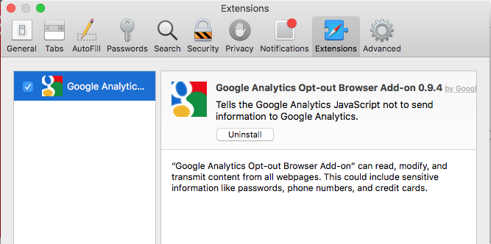
Google Analytics Opt-out Browser Add-on
Google Analytics Reports
Install the Google Analytics Opt-out Browser Add-on https://tools.google.com/dlpage/gaoptout
Opts you out of all sites, not just your site
Use a different Browser to visit other UNL sites
Safari Extensions

Slide 26
How do I run a report for specific pages?
Google Analytics Reports
Use the advance search filter
Select Include: Page: Matching RegExp
Enter pages in search box separated with a pipe |
|
\
shift

Slide 27
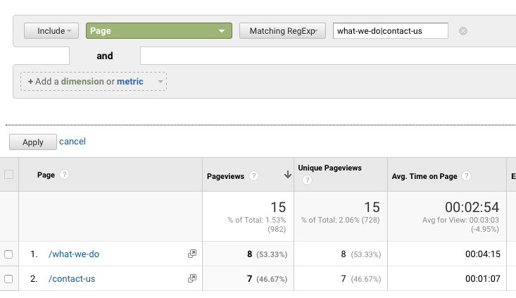
Google Analytics Reports
Behavior>Site Content>All Pages

Slide 28
Google Analytics Reports
Behavior>Site Content>All Pages
^ begins with
$ ends with
| or
Google Analytics Regular Expressions
https://support.google.com/analytics/answer/1034324?hl=en

Slide 29
Google Analytics Reports
Color Contrast Tool
https://snook.ca/technical/colour_contrast/colour.html
MediaHub Code for Google Tracking
http://wdn.unl.edu/documentation/unl-mediahub/embed-code
Icon Font Sample Code
http://wdn.unl.edu/documentation/icons
Google Analytics Dimensions and Metrics
https://support.google.com/analytics/answer/1033861?hl=en
IP Range Regular Expression Builder
http://www.analyticsmarket.com/freetools/ipregex
Google Analytics Regular Expressions
https://support.google.com/analytics/answer/1034324?hl=en
Google Analytics Opt-out Browser Add-on https://tools.google.com/dlpage/gaoptout
Online resourcess

Slide 30
IANR WEB MANAGER NETWORK
Next meeting June, 2017
TBA

